Slide 1

HEALTHCARE ANALYTICS
Princy S
Data Is The Heartbeat Of Modern Healthcare - Transforming Raw Numbers Into Life-Saving Insights.

Slide 2
ABOUT HEALTHCARE ANALYTICS
Healthcare analytics transforms raw data into actionable insights, improving patient care, reducing costs, and optimizing resources. By leveraging data from patient records, wearables, and public health databases.
Descriptive Analytics
Understanding past trends.
Predictive Analytics
Prescriptive Analytics
Forecasting future outcomes.
Recommending optimal actions.

Slide 3
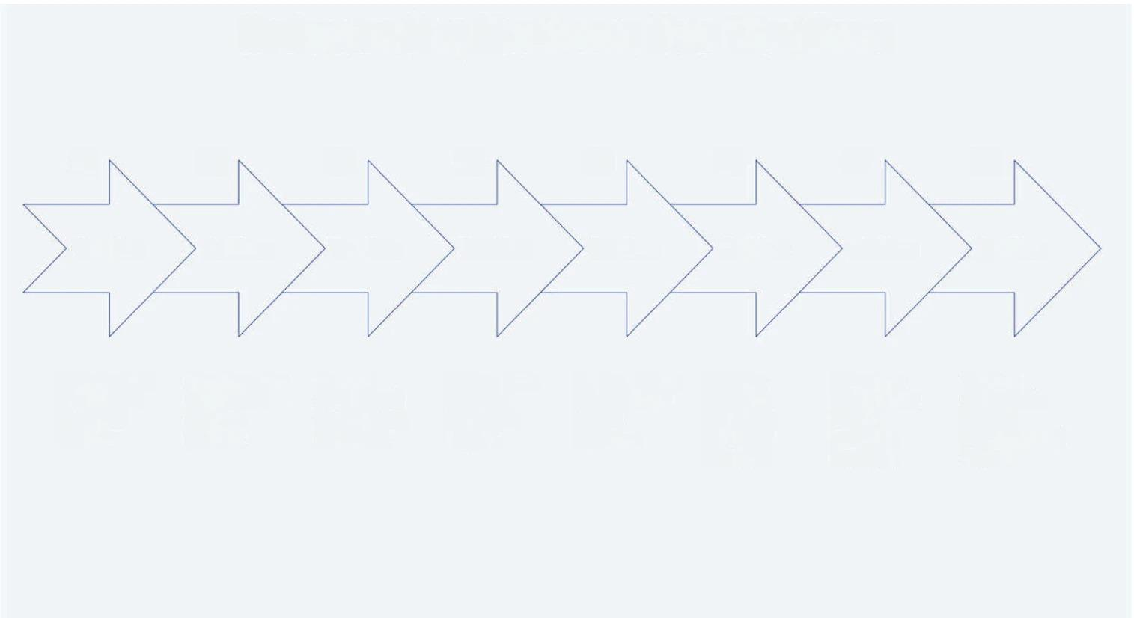
MECHANISM WORKFLOW
Data Gathering
Data Integration
Data Validation
Data
Analysis
Predictive Modeling
Insight Generation
Workflow Integration
Outcome Evaluation
Gathering data from various healthcare sources.
Combining data into a unified database platform.
Ensuring accuracy and completeness of the data.
Analyzing data to extract meaningful insights.
Using models to forecast future patient outcomes.
Providing actionable insights for healthcare decisions.
Integrating analytics into clinical workflows smoothly.
Tracking outcomes to evaluate effectiveness of actions.

Slide 4
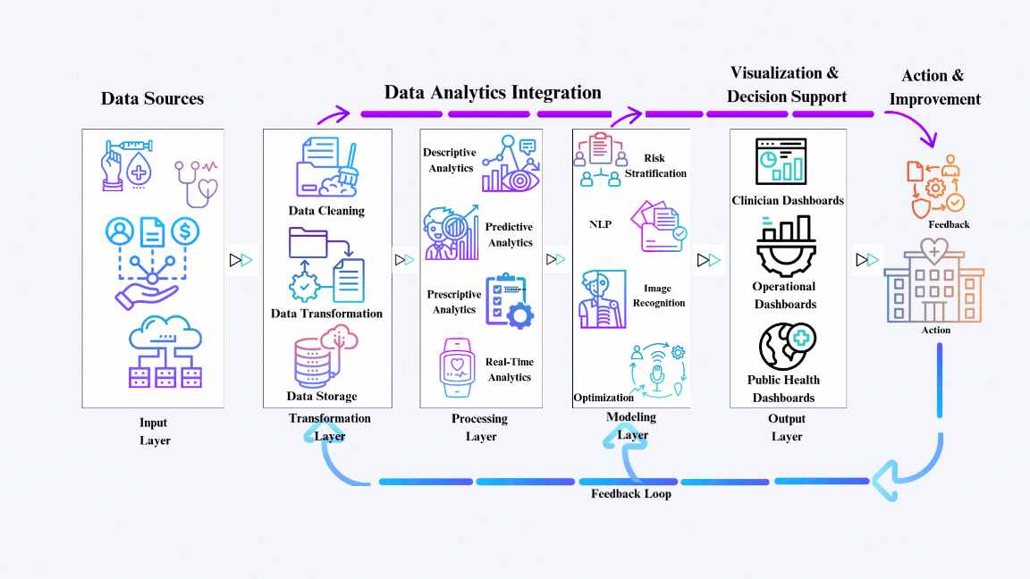
FLOWCHART

Slide 5
FLOWCHART EXPLANATION
Data Sources (Input Layer) - Healthcare data is collected from various sources Clinical Data: EHRs, Operational Data, Patient Generated Data, External Data. | Data Integration and Storage (Transformation Layer) - Raw data undergoes cleaning and structuring: Data Cleaning: Fixing errors and filling gaps in data. Data Transformation: Converting unstructured inputs using NLP tools. Data Storage: Real-Time Data: Stored in modern Data Lakehouses Eg - Snowflake Batch Data: Managed in Data Warehouses Eg - BigQuery | Analytics and Insights (Processing Layer) - Advanced analytics extract valuable insights: Descriptive Analytics: Review historical trends. Predictive Analytics: Anticipate future events like readmissions. Prescriptive Analytics: Provide actionable solutions for staffing and treatments. Real-Time Analytics: Deliver instant alerts from IoT devices. | Machine Learning and AI (Modeling Layer) - AI-driven models enhance decision-making Risk stratification to identify high-risk patients. NLP for processing medical text. Image recognition for diagnosing conditions. Optimization models for efficient care and resource use. | Visualization and Decision Support (Output Layer) - Insights are displayed using dashboards Clinical Dashboards: Monitor patient metrics and treatments. Operational Dashboards: Analyze resource utilization and costs. Public Health Dashboards: Visualize disease trends and outbreaks.
Action and Feedback (Loop Layer) - Insights lead to actions and continuous improvements: Action: Enable stakeholders to optimize care plans and resource allocation. Feedback: Use outcomes to refine analytical models and enhance systems.

Slide 6
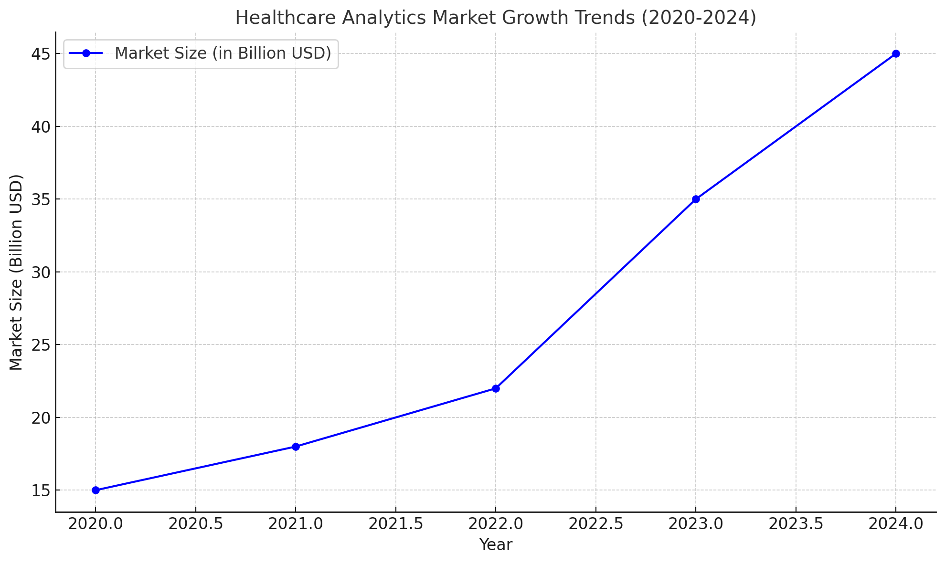
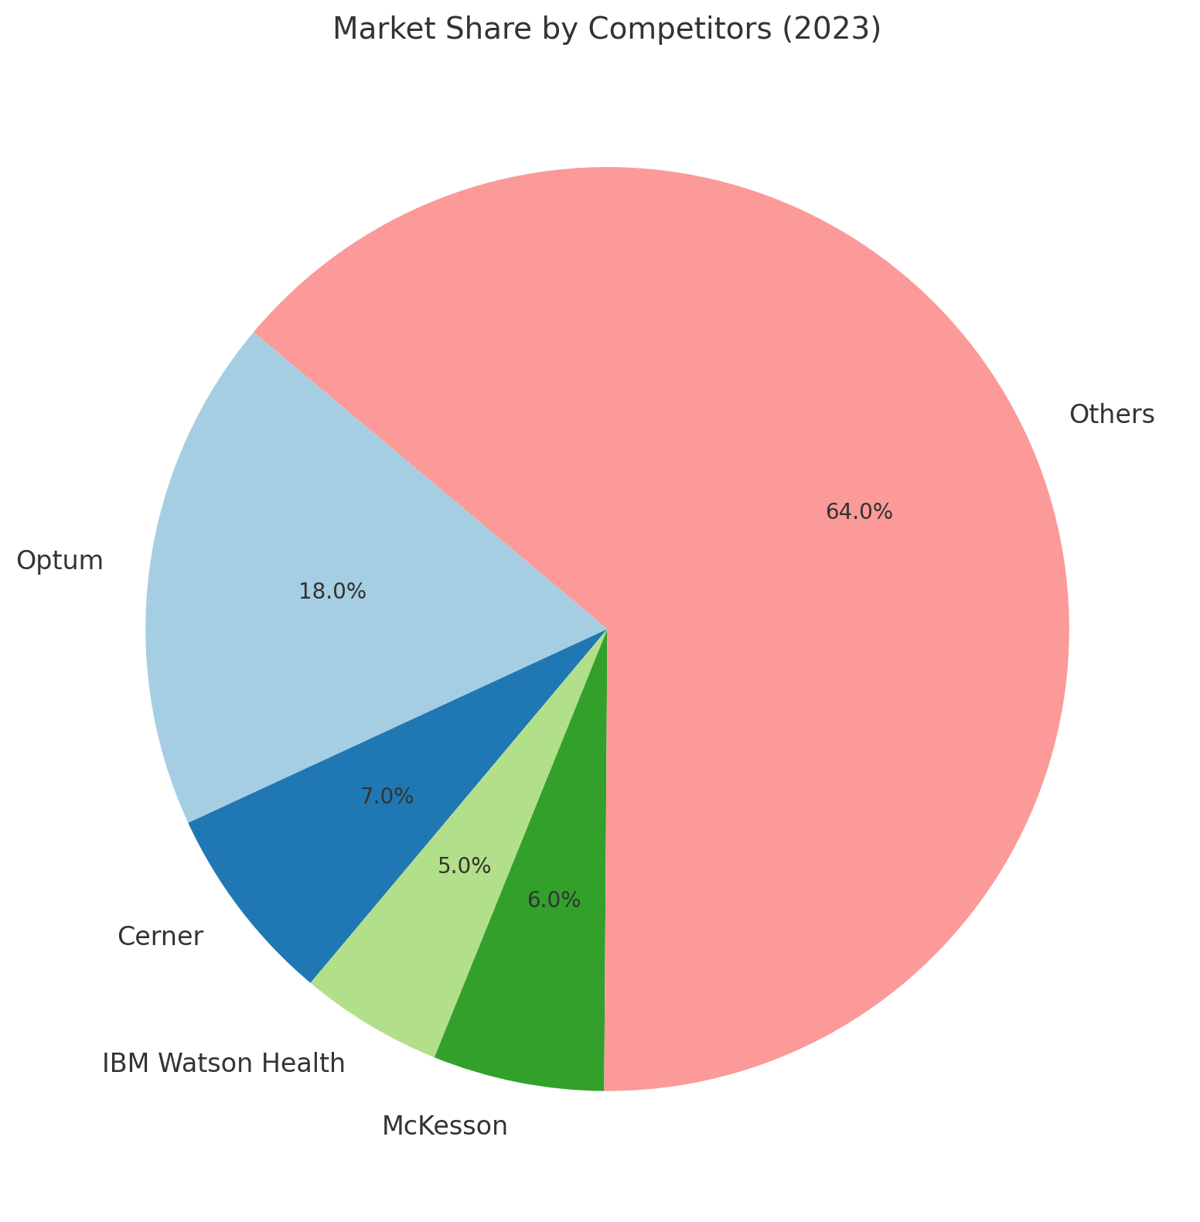
MARKET RESEARCH AND COMPETITOR ANALYSIS
Healthcare Analytics Market Growth Trends (2020-2024)
Market Share by Competitors (2023)
Rapid Market Expansion: The market size is projected to grow significantly from $15 billion in 2020 to an estimated $45 billion in 2024, indicating a robust CAGR.
High Growth Potential: This rapid growth signifies a substantial market opportunity and attracts investment from various players.
Optum's Market Leadership: Optum holds the second-largest market share (18%), establishing itself as a key player in the healthcare analytics sector.
‘Others’ Dominate: A large portion of the market (64%) is held by a diverse range of smaller players, highlighting a fragmented landscape.

Slide 7
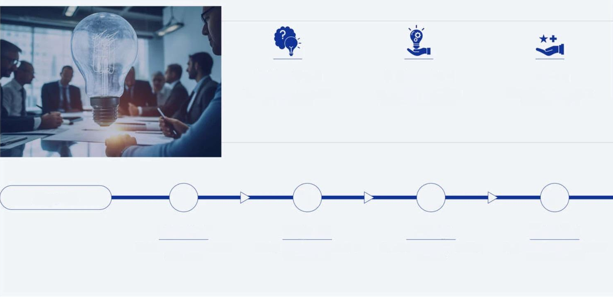




CASE STUDY FOR PREDICTING PATIENT READMISSIONS
PROBLEM STATEMENT
SOLUTION OFFERED
BENEFITS
Hospitals face significant costs and penalties associated with patient readmissions within 30 days of discharge.
Predictive analytics helps identify patients at high risk of readmission, allowing healthcare providers to take preventive measures.
Reduced Readmissions: Hospitals can reduce penalties and improve patient outcomes.
Cost Savings: Focused interventions lower overall healthcare costs.
Improved Patient Care: Timely follow-ups enhance patient satisfaction and safety.
APPROACH
Methodology
Predictive Model Insights
Visualizations
Insights and Actions
Data Collection
Data Preprocessing
Model Selection
Model Training & Validation
Logistic Regression: For binary classification (readmitted or not).
Random Forests: For better accuracy and interpretability.
Neural Networks: For complex relationships in large datasets.
Confusion Matrix
Feature Importance
ROC Curve
Post-discharge follow-ups.
Medication reviews.
Home health visits.

Slide 8
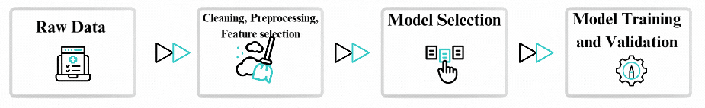

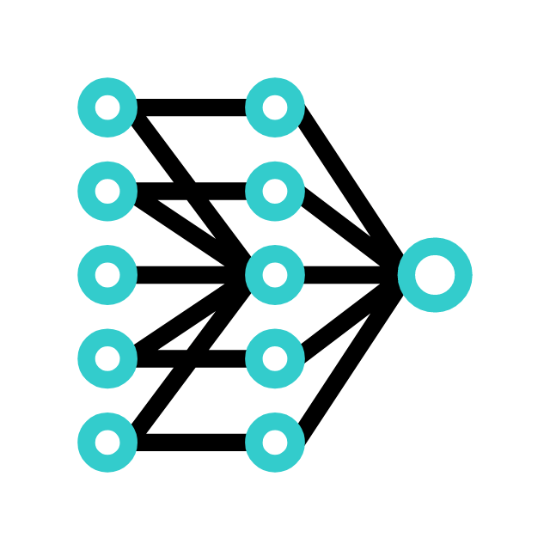

USE CASE FOR OPTIMIZING PATIENT READMISSIONS THROUGH PREDICTIVE HEALTHCARE ANALYTICS
Methodology
Predictive Model Insights
Logistic Regression
Neural Networks
Random Forests
Predicting 30-day readmission based on age, medical history, and previous hospital visits. Example: At St. John's Hospital, this model predicts the likelihood of a heart disease patient being readmitted based on past admissions and health conditions. Around 75-80% for heart disease readmission predictions.
Predicting readmission for patients with diverse medical backgrounds using large datasets. Example: At St. John's Hospital, neural networks analyze patient data, including lab results and demographics, to predict cancer patients' readmission risk with high accuracy. Around 90-95% for cancer patient readmission predictions.
Identifying key factors (e.g., treatment type, diagnosis, patient age) contributing to readmission. Example: At St. John's Hospital, random forests predict readmission risk for diabetic patients by considering various health metrics like glucose levels and previous hospital stays. Around 85-90% for diabetic patient readmission predictions.

Slide 9
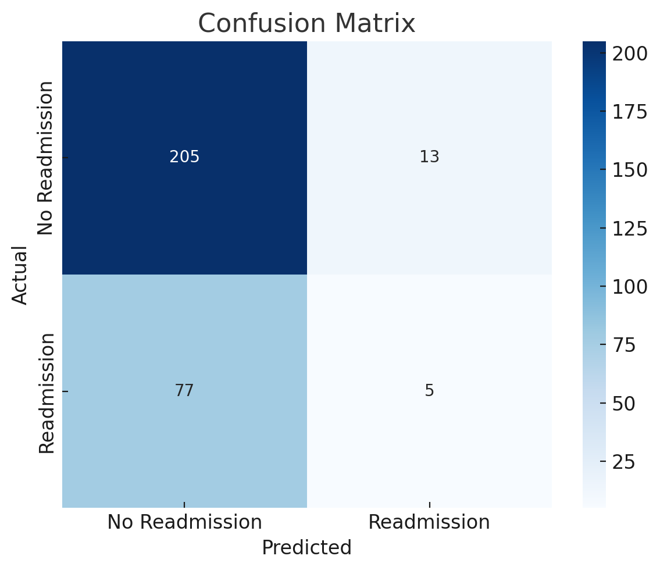
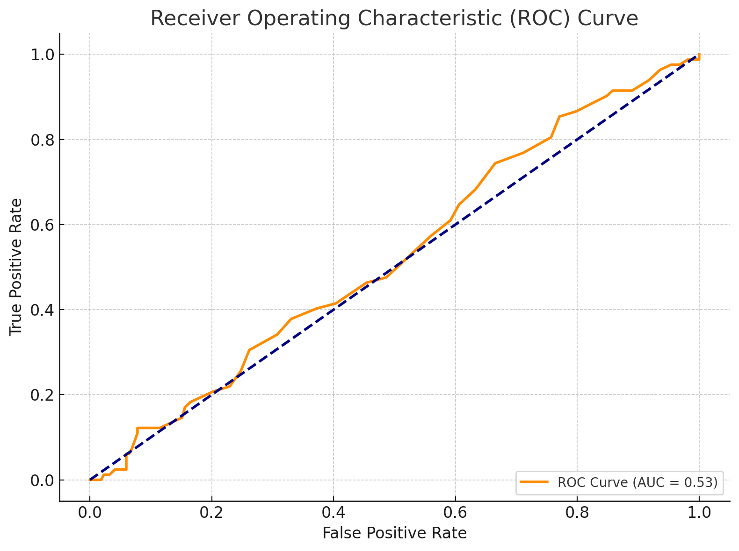
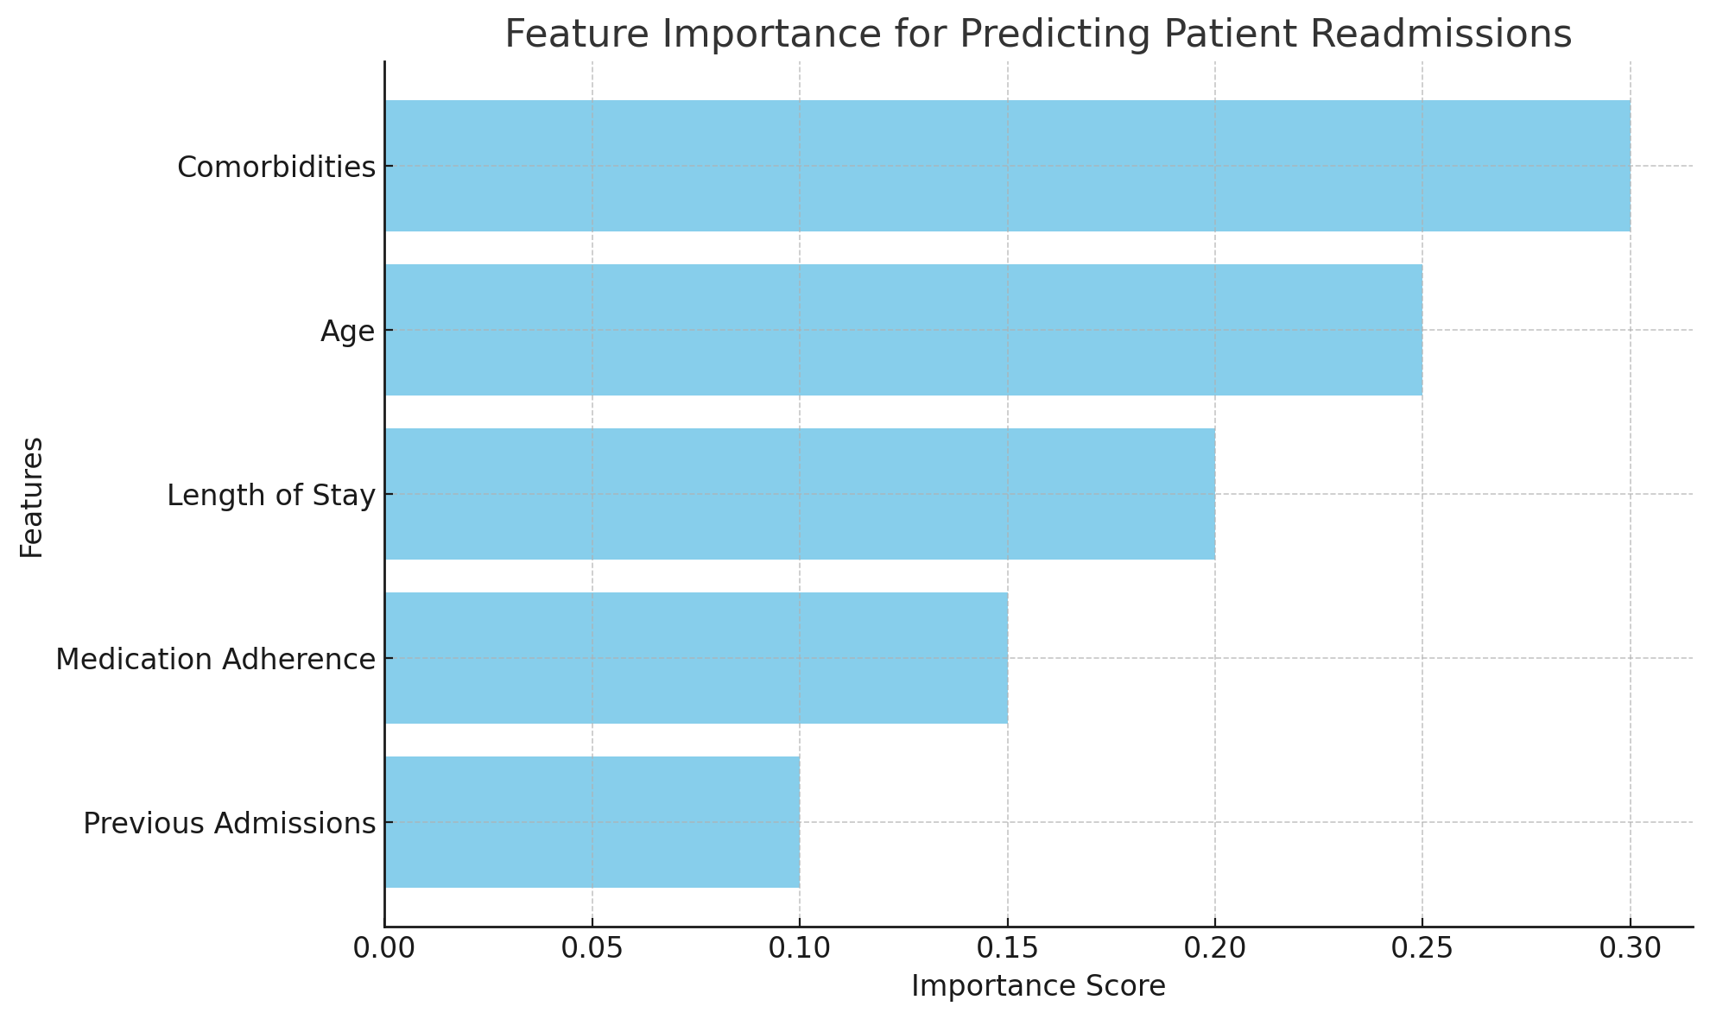
USE CASE FOR OPTIMIZING PATIENT READMISSIONS THROUGH PREDICTIVE HEALTHCARE ANALYTICS
Visualizations
CONFUSION MATRIX
ROC CURVE
FEATURE IMPORTANCE
This matrix assesses the model's accuracy in predicting readmission outcomes.
True Positives (TP): The model correctly identified patients who were readmitted.
True Negatives (TN): The model accurately predicted patients who did not require readmission.
False Positives (FP): The model incorrectly flagged patients as likely to be readmitted (false alarms).
False Negatives (FN): The model failed to identify patients who were subsequently readmitted (missed opportunities for intervention).
The ROC curve visualizes the balance between sensitivity (correctly identifying actual readmissions) and specificity (correctly identifying those without readmission) at various thresholds.
A larger Area Under the Curve (AUC) indicates superior model performance in distinguishing between readmission and non-readmission cases.
The Bar chart ranks the factors that most significantly influence the model's readmission predictions.
By understanding key factors(Age, Length of stay, Medication Adherence, Previous Admission), we can focus interventions on the areas with the highest potential impact.

Slide 10
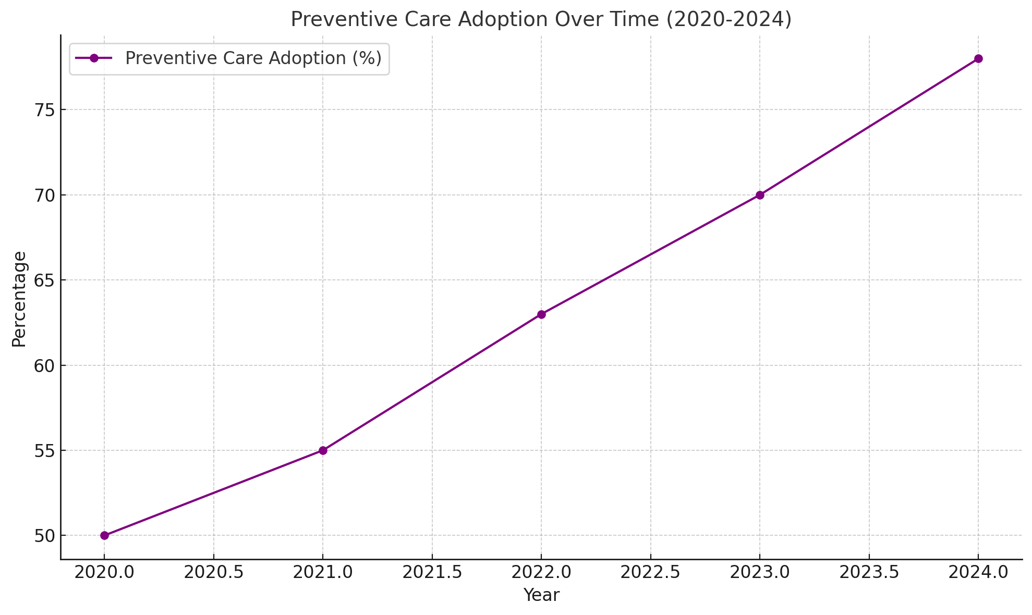
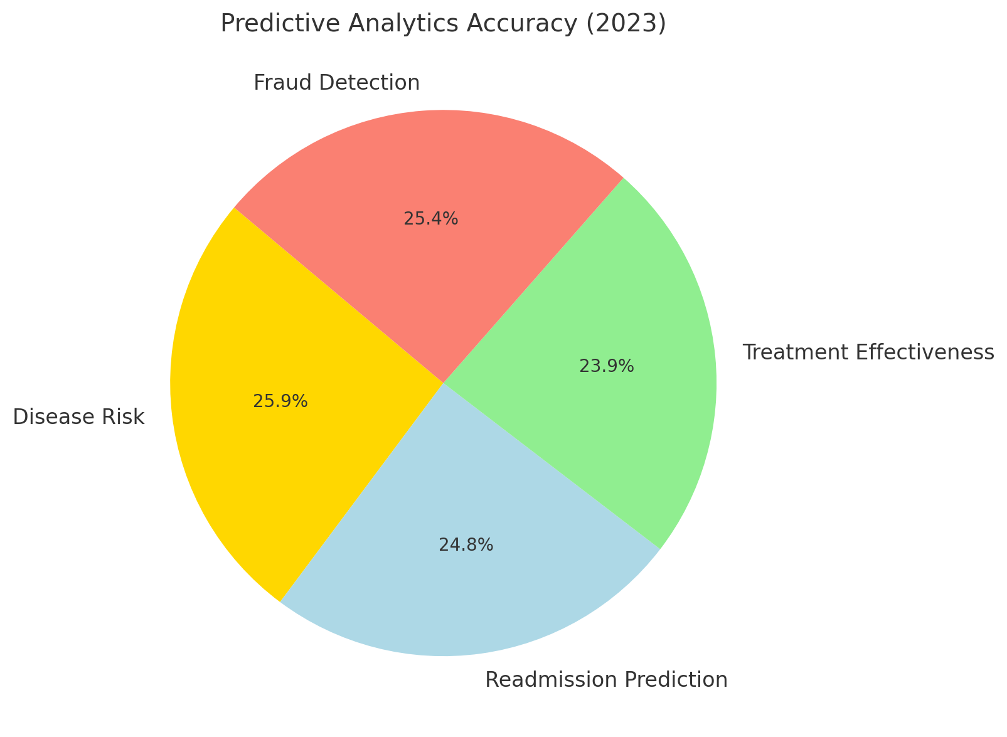
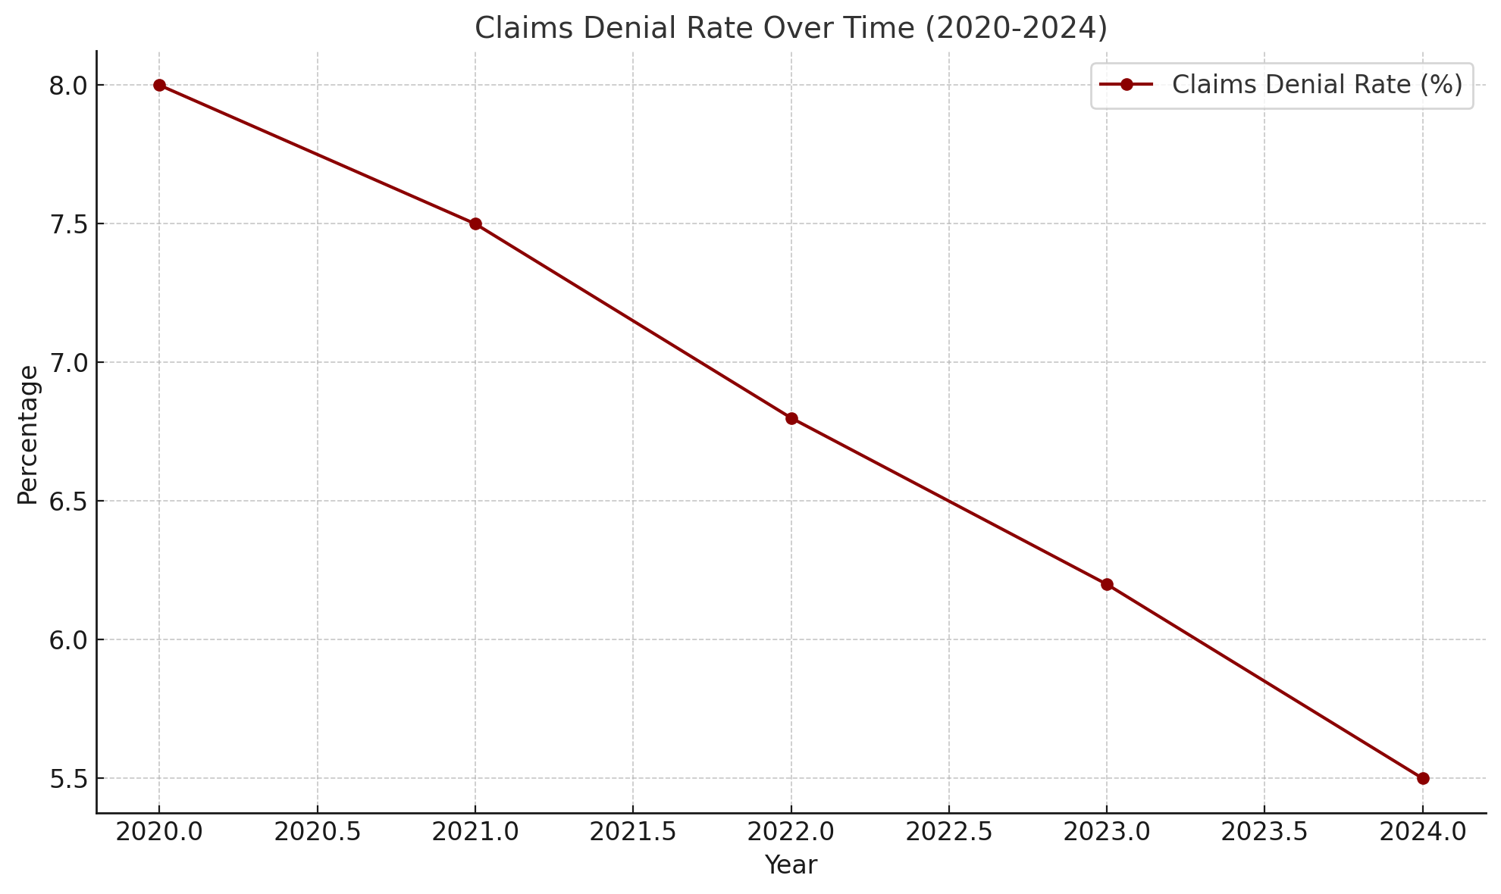
VISUALIZATION FOR KPIs
Highlights a 20% growth in adoption rates over five years, driven by awareness campaigns and analytics.
The effectiveness of AI/ML models in predicting disease risks, with a 92% accuracy for cardiovascular diseases leading the way.
Highlights how analytics can reduce claims denial rates (average below 5%) through accurate data capture and process optimization.

Slide 11
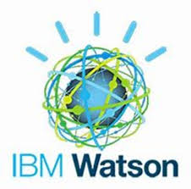
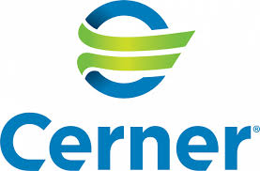

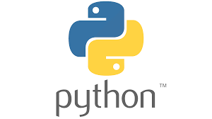
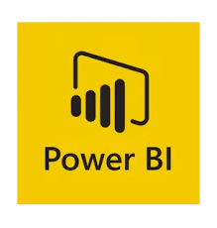
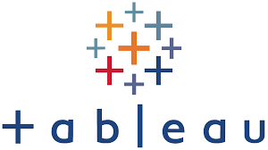
Empowering healthcare with actionable intelligence - turning data into decisions, decisions into better care, and driving growth, efficiency, and transformative patient outcomes.
BUSINESS IMPACT
CAPABILITIES
Proactive Health Predictions: Leverage predictive models to identify potential risks for chronic diseases, enabling timely interventions. Ex: Using tools like IBM Watson Health to predict diabetes progression and cardiovascular events based on patient data.
Streamlined Hospital Operations: Optimize hospital workflows by analyzing operational data. Ex: Tableau and Power BI can visualize patient flow patterns, enabling hospitals like Cleveland Clinic to reduce wait times and improve efficiency.
Tailored Patient Care: AI-powered platforms such as Health Catalyst assist in designing personalized treatment plans by analyzing medical history, genetics, and real-time health metrics. Ex: Mayo Clinic utilizes AI for personalized cancer treatment protocols.
Community Health Insights: Analyze population health trends using tools like SAS Analytics, which public health agencies use to track outbreaks and allocate resources effectively. Ex: during COVID-19, governments used these insights to prioritize vaccine distribution.
Fraud Detection Systems: Employ advanced Machine Learning Algorithms to detect anomalies in billing and insurance claims. Ex: Companies like Optum leverage such tools to uncover fraudulent activities, saving millions in healthcare expenses annually.
BUSINESS IMPACT
Cost Savings - Our healthcare solutions can reduce operational costs by 24-30% through enhanced process efficiency in hospital operations, resource allocation, and billing accuracy. Ex: Apollo Hospitals, Chennai (Tamil Nadu) implemented predictive analytics to optimize resource allocation, reducing labor costs by 28% and enhancing operational efficiency.
Increased Productivity - Our approach boosts clinical workflow efficiency by 25-35%, automating repetitive tasks and enabling staff to focus on critical care. Ex: Fortis Healthcare, Gurugram (Haryana) used AI-powered tools to streamline patient onboarding, reducing manual administrative work by 30%.
Revenue Growth - Analytics can drive revenue growth by 20-25% through better patient retention, optimized resource utilization, and new service offerings. Ex: Manipal Hospitals, Bengaluru (Karnataka) leveraged patient analytics to create tailored health packages, boosting retention rates and increasing revenue by 22%.
Sustainability - Data analytics contributes to reducing waste and energy consumption, potentially lowering environmental impact by 20-25% in healthcare facilities. Ex: Narayana Health, Bengaluru (Karnataka) implemented IoT-based energy monitoring systems, achieving a 21% reduction in energy consumption and lowering operational costs.
TOOLS EXPERTISE

Slide 12
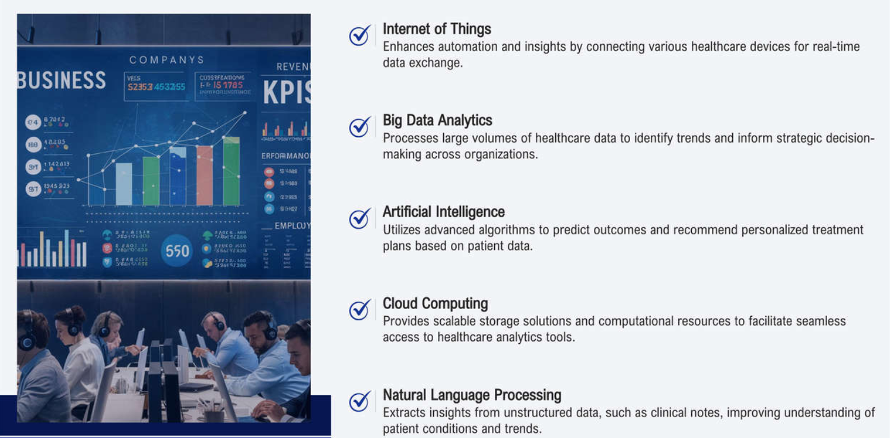
TECHNOLOGIES EXPERTISE

Slide 13
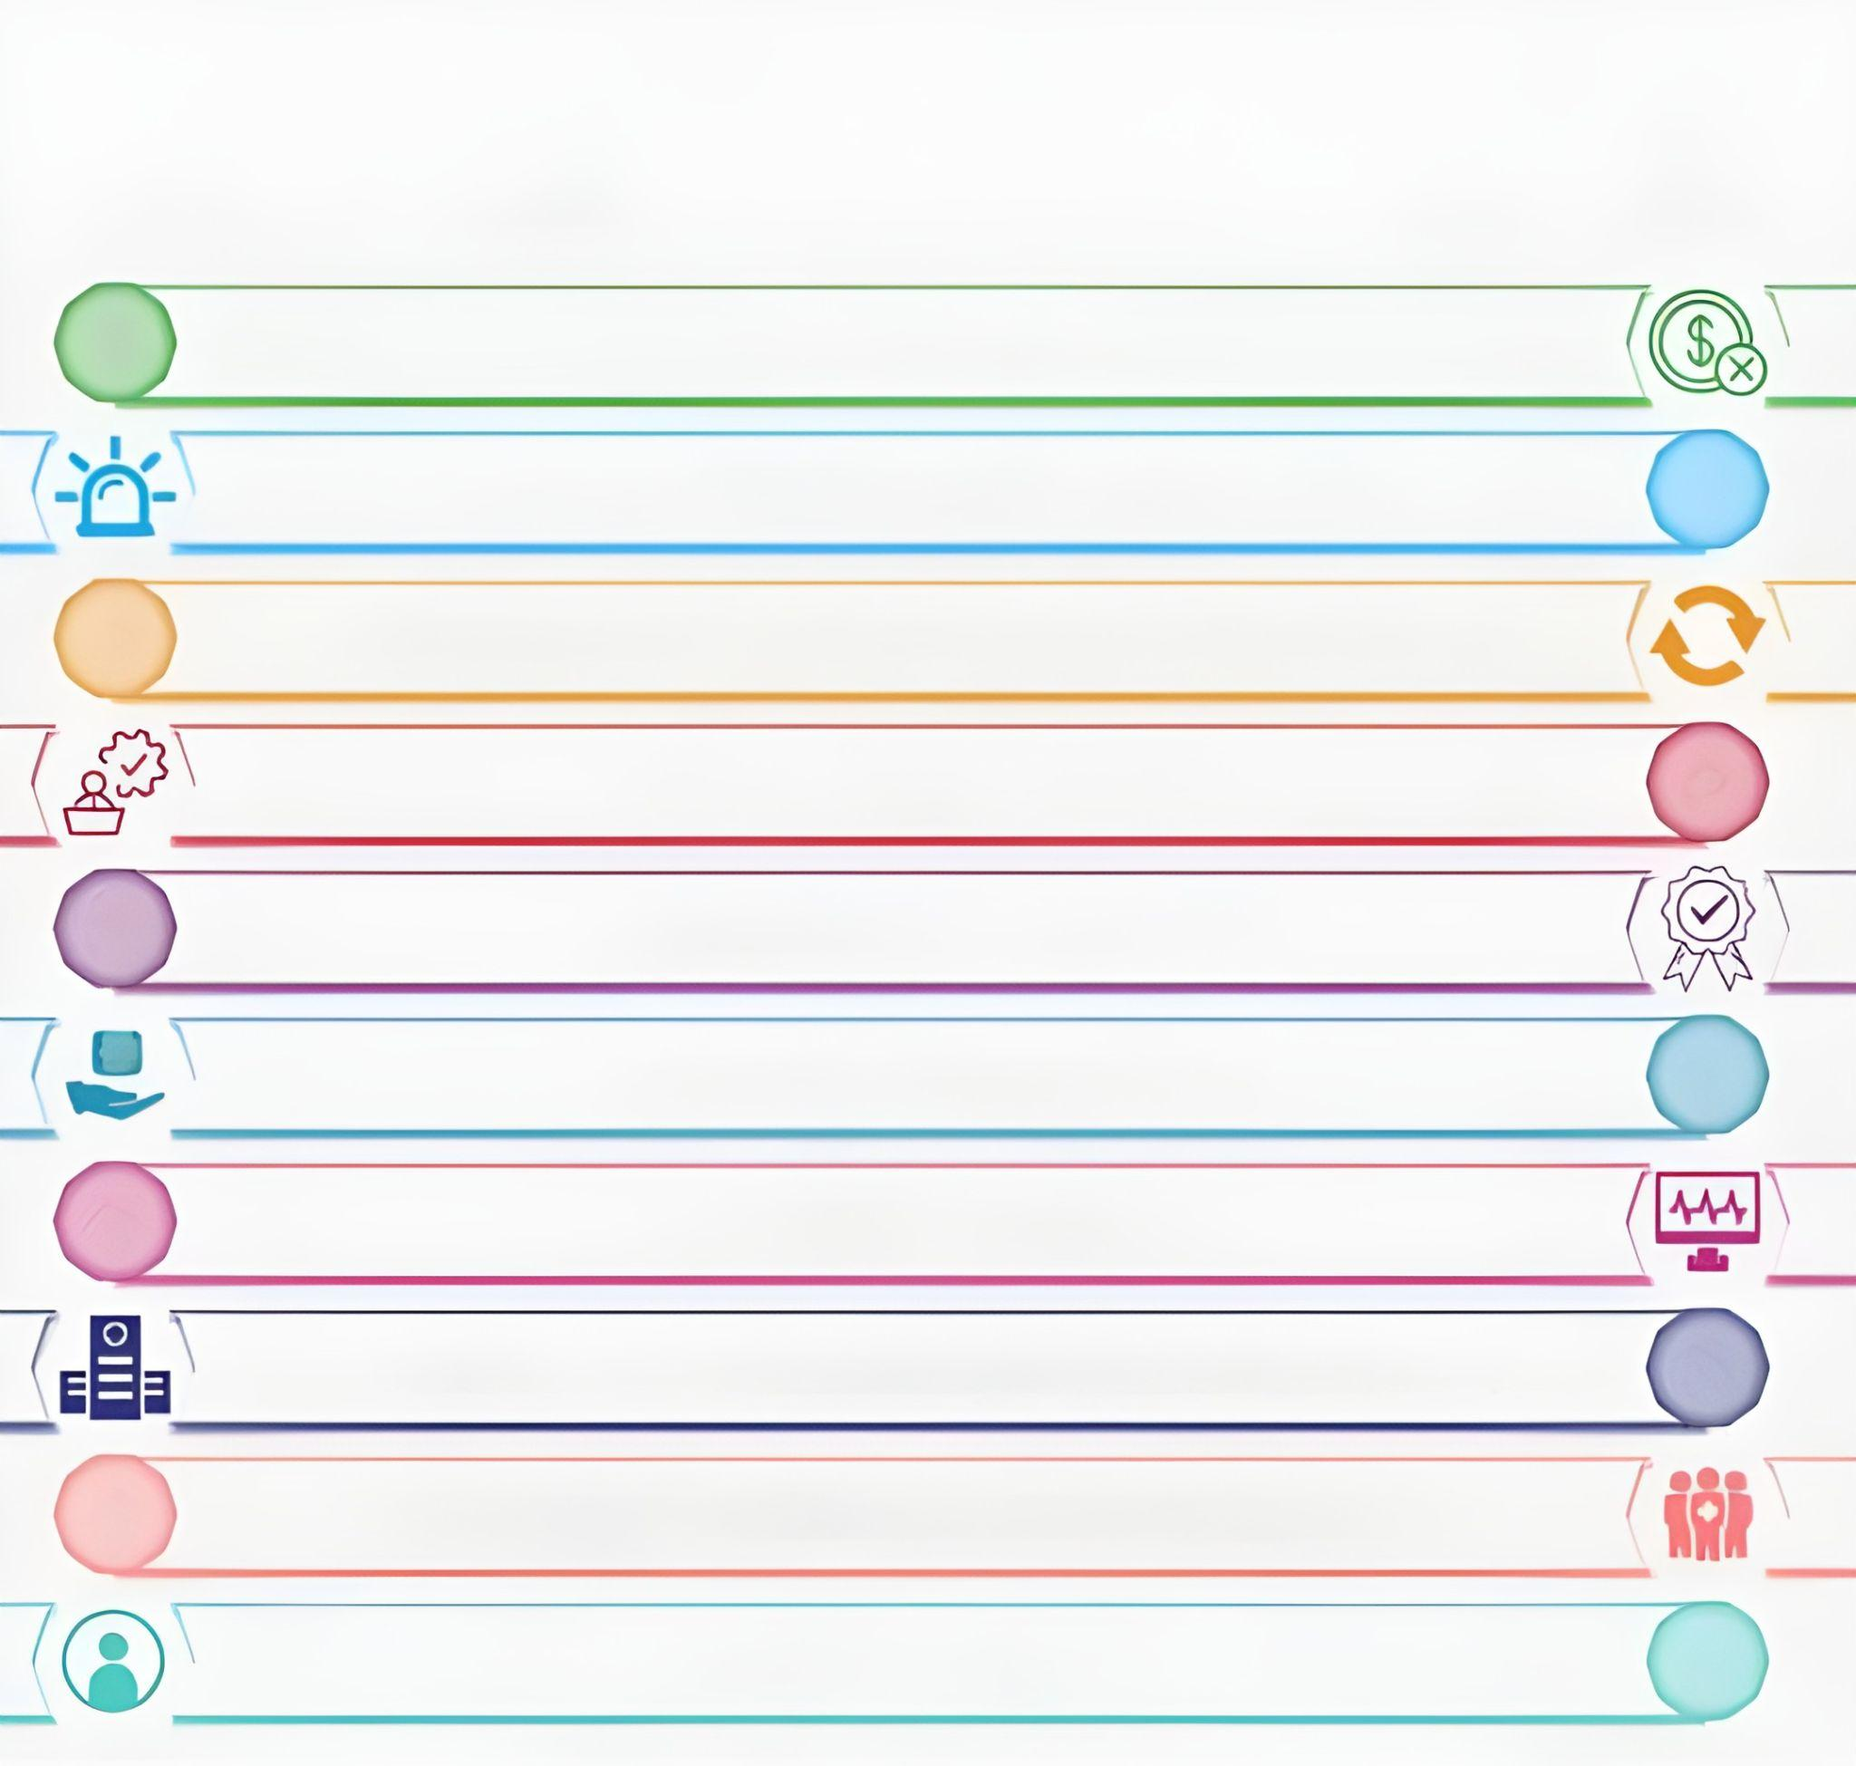
10 MOST SIGNIFICANT FORCES SHAPING THE NEW ERA OF HEALTHCARE
1
Financial Woes
Rising demand for outcome based care
2
3
Advances in clinical knowledge and technology
Transforming patient needs
4
5
Shortage of skilled workforce
Higher patient expectation
6
7
Digital enabled care delivery
Need for high-volume single speciality centers
8
9
Emerging care delivery in community settings
Rise of patient centricity
10

Slide 14
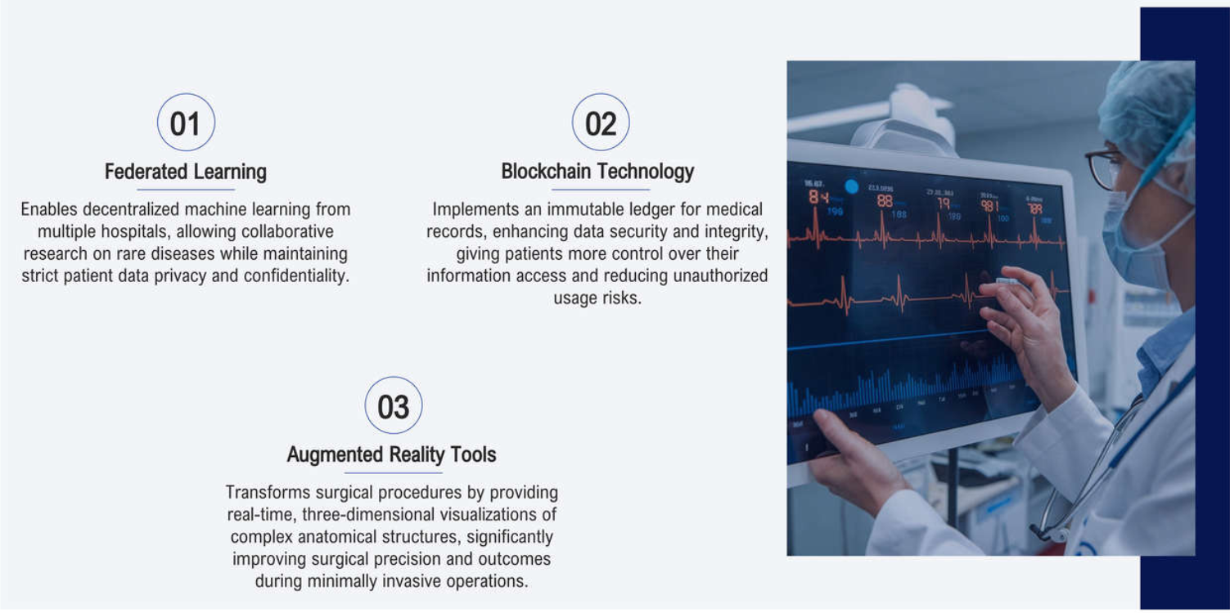
EMERGING TRENDS IN HEALTHCARE ANALYTICS

Slide 15
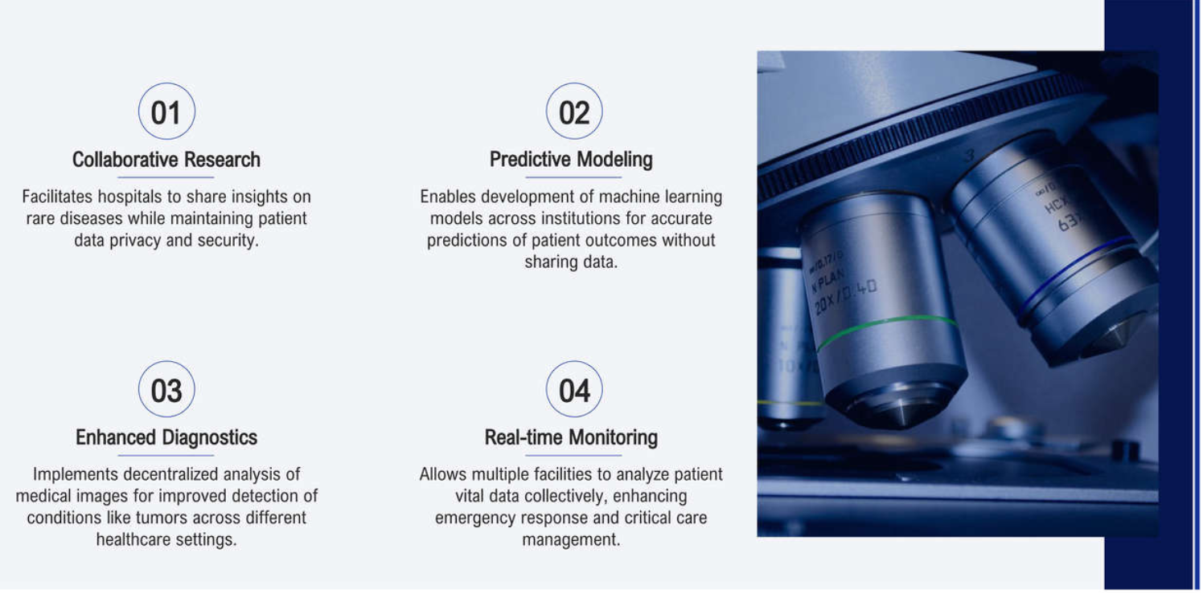
FEDERATED LEARNING IN HEALTHCARE APPLICATIONS

Slide 16
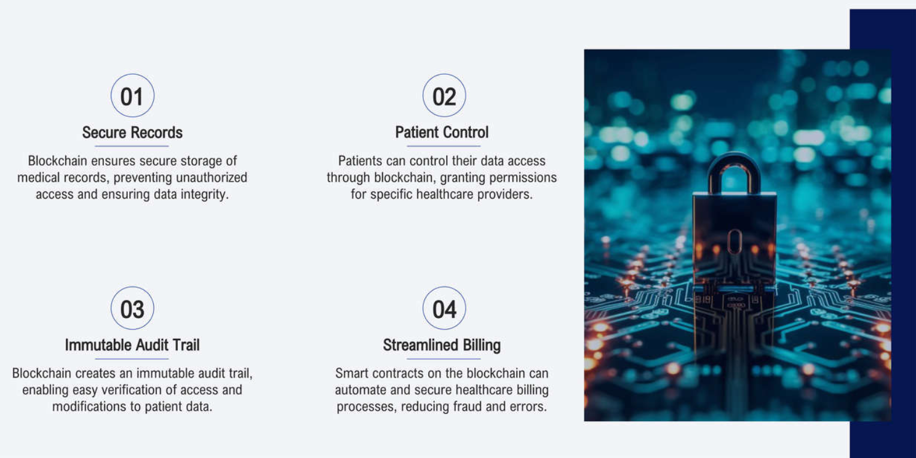
BLOCKCHAIN TECHNOLOGY FOR DATA SECURITY

Slide 17
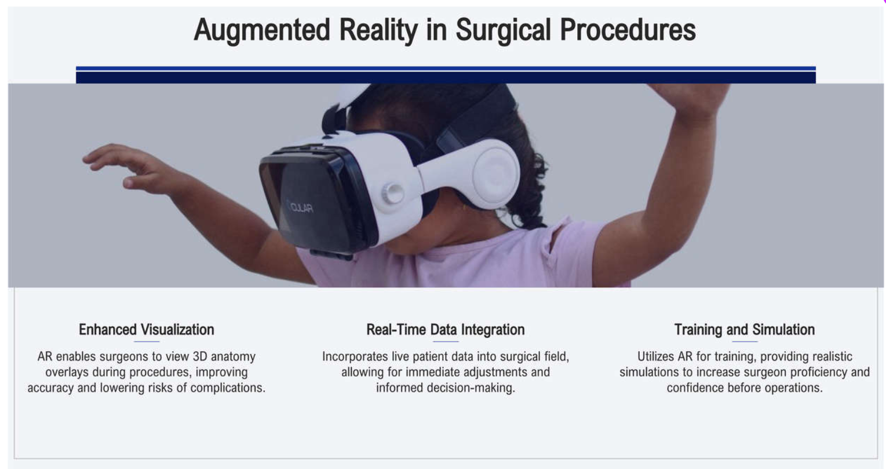
AUGMENTED REALITY IN SURGICAL PROCEDURES

Slide 18

DIGITAL CHALLENGES IN HEALTHCARE ANALYTICS
Deficit in advanced health technology
Integrated system
for data management
Patient
centric care
Shift to
data culture
Cybersecurity
Digitization and
Digital transformation

Slide 19
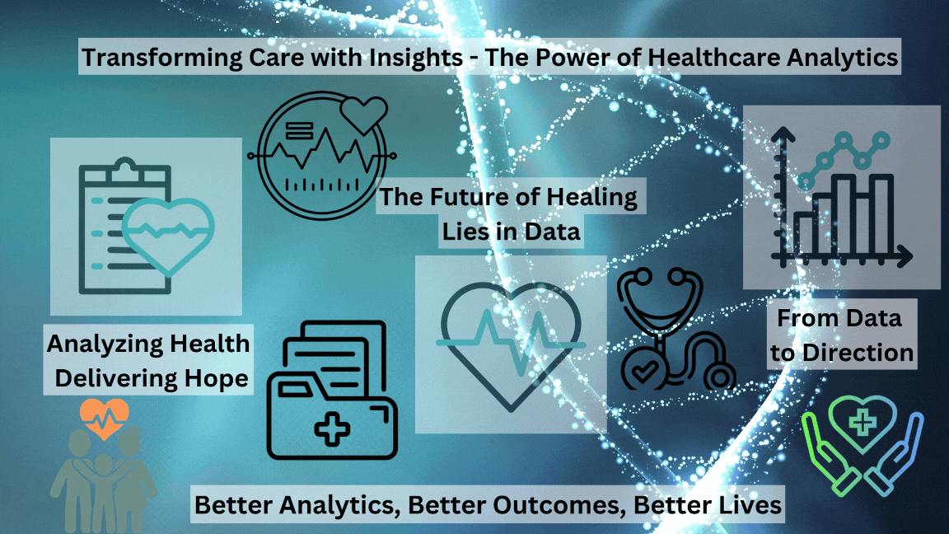
REVOLUTIONIZING HEALTHCARE WITH DATA ANALYTICS

Slide 20

FINAL THOUGHTS ON HEALTHCARE ANALYTICS
Transforming Patient Care
Healthcare analytics enhances decision-making, improving overall patient treatment outcomes
Cost Reduction Strategies
Utilizing analytics can significantly lower operational costs and enhance resource allocation.
Predictive care
Predictive models help forecast patient outcomes, reducing readmission rates effectively.
Enhanced Patient Engagement
Wearables and mobile apps foster active participation in personal healthcare management.
Addressing Data Security
Implementing robust encryption is vital to protecting sensitive patient information.
Future Trends to Watch
Emerging technologies like blockchain and AR promise to revolutionize healthcare analytics.

